Slide 1
2020 - 2021 RETIREES

Slide 2
HONORING 2020-2021 RETIREES UNIVERSITY OF WEST GEORGIA ASSOCIATION OF RETIRED FACULTY AND STAFF FALL, 2021

Slide 3
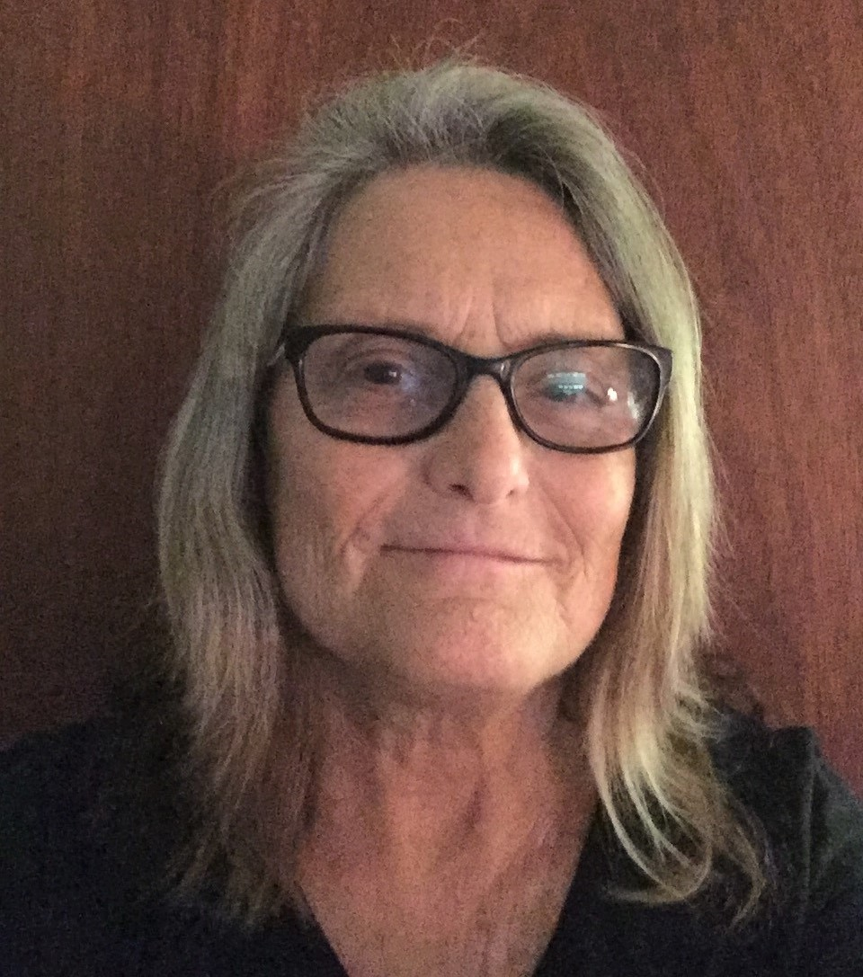
PATRICIA BROOKS
Public Control Officer and Bus Driver in Public Safety and Parking & Transportation
2003-2020
Plans for retirement: enjoying life!

Slide 4
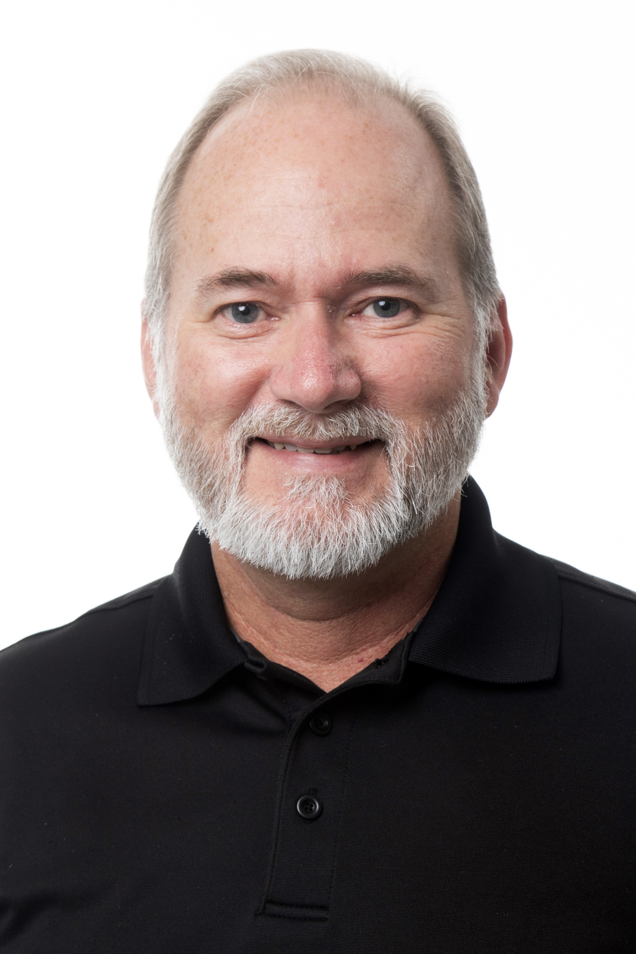
STEVEN BROOME
Photographer, Assistant Director, Associate Director for Visual Services, Director of Photography and Video in Public Relations/University Communications and Marketing
1989-2020
Plans for retirement: continuing to teach/consult/ freelance photography and video production through his business, Jastesa Photographic Resources; continuing his blog/website – Vintage Camera Digest – where he uses, reports on, and sometimes repairs his vintage camera collection – vintagecameradigest.wordpress.com

Slide 5
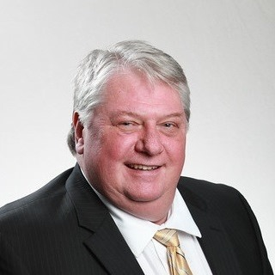
DENNY CHASTEEN
Applications Development Manager in Information Technology Services
2007-2020
Plans for Retirement: working with younger musicians in his not-for-profit recording music studio

Slide 6
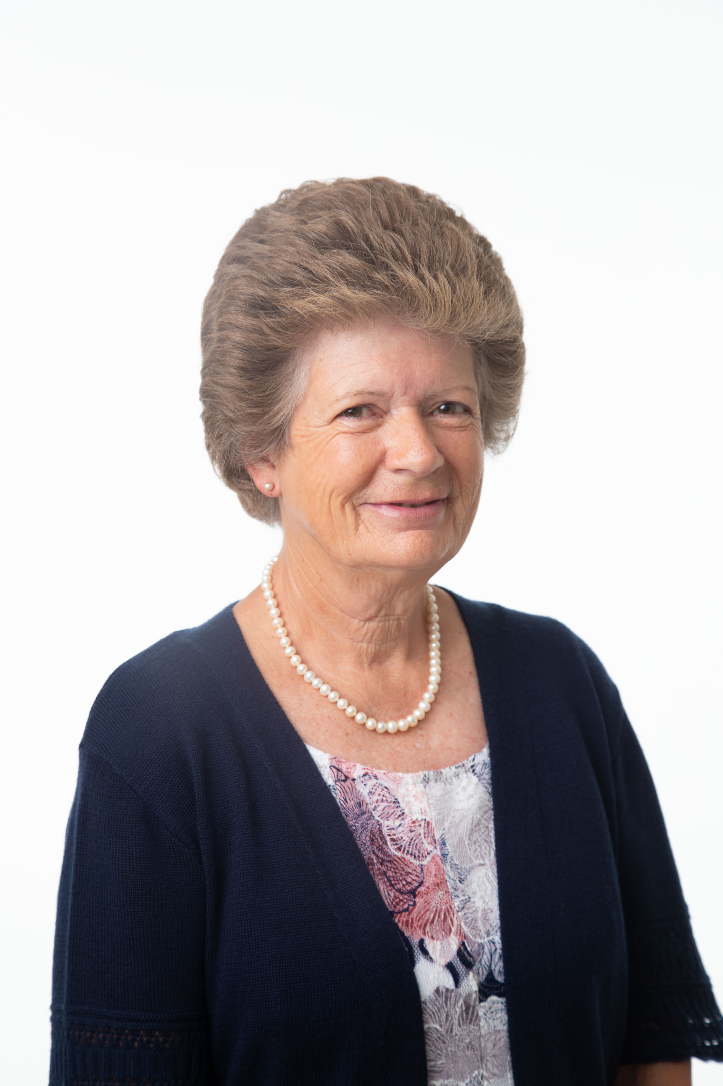
BECKY COLE
Department Assistant – Intermediate in Accounting & Finance
1994-2020
Plans for retirement: gardening and other outside work, remodeling her home, making crafts of all kinds, planning regular trips to Michigan to see her two grandchildren

Slide 7
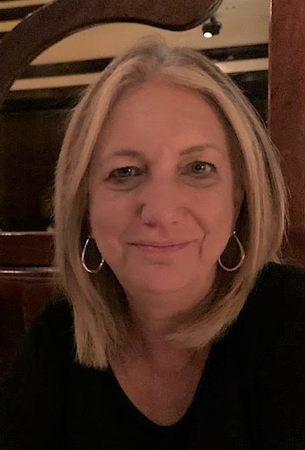
LISA CRAFTON
Professor of English
1987-2020
Plans for retirement: traveling, cooking, gardening

Slide 8
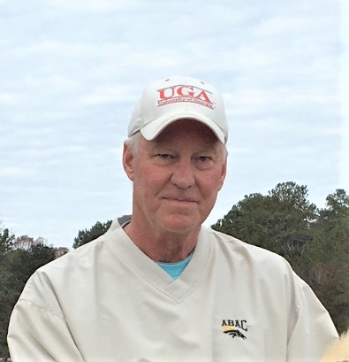
JOE DOUGLAS
Lab Coordinator in Biology
1991-2020
Plans for retirement: riding and taking care of his horses, continuing his work with real estate appraisals

Slide 9
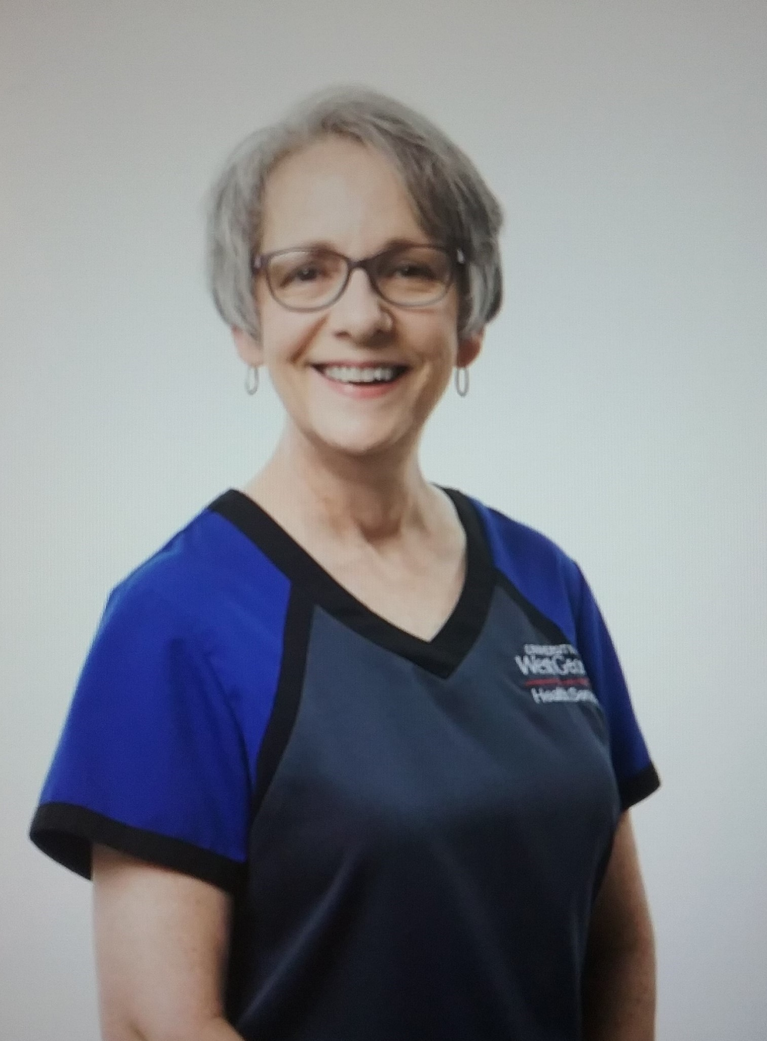
KAY FARR
Licensed Practical Nurse in Health Services
2009-2020
Plans for retirement: continuing to assist part-time with the UWG COVID Clinic; reading, biking, and walking her dog; spending time with her family; visiting all the national parks

Slide 10
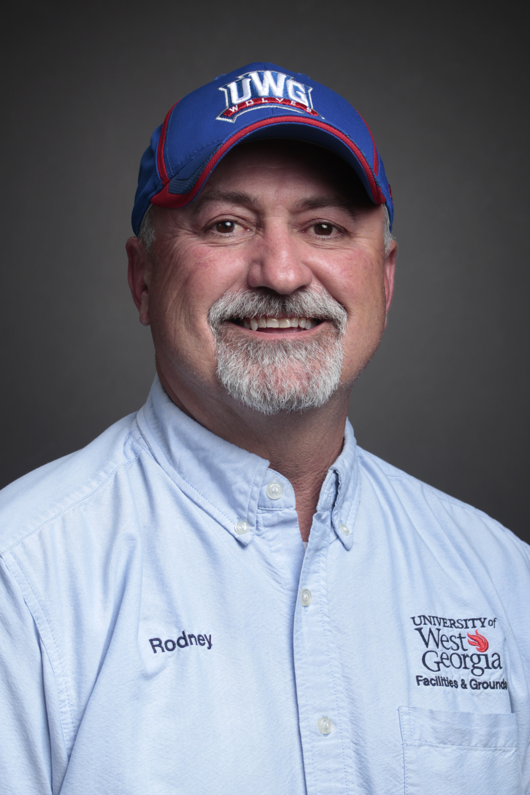
RODNEY GIBBS
Building Maintenance Supervisor in Facilities and Grounds
1993-2021
Plans for retirement: camping, visiting relatives out of state, doing “country boy” stuff like hunting and fishing

Slide 11
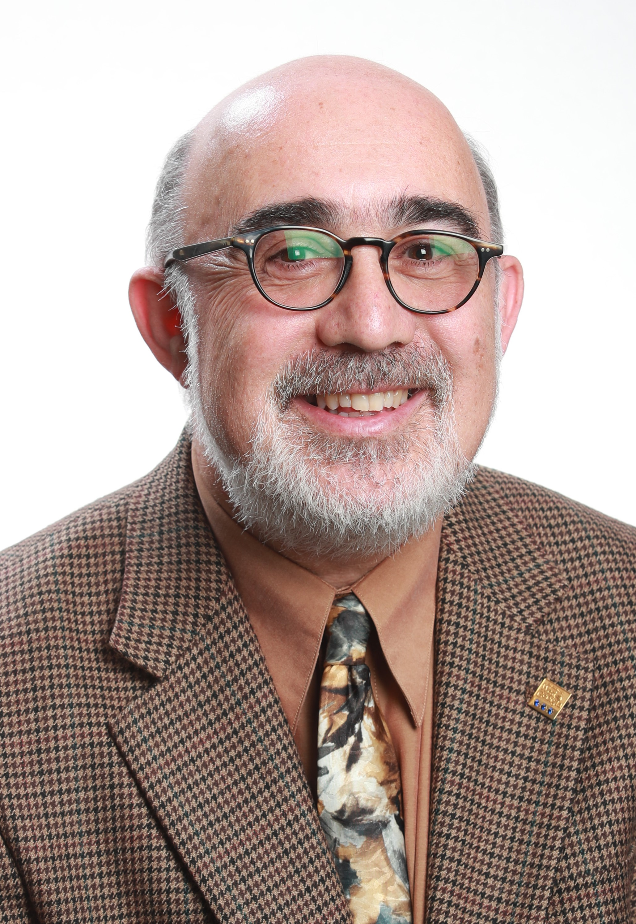
VEDAT GUNAY
Project Manager in Information Technology Services
1984-2020
Plans for retirement: traveling, painting pictures, playing soccer

Slide 12
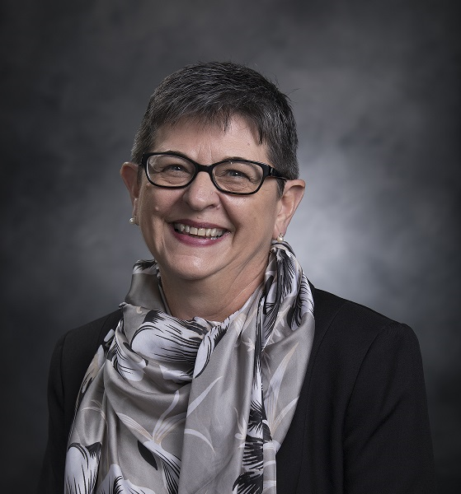
VICKI HARDIN
Associate Director, Employer Relations in Career Services
2004-2020
Plans for retirement: traveling with her husband, getting settled in the new house they are building, finally having time to organize and archive family pictures, volunteering some time with one of the local nonprofits

Slide 13
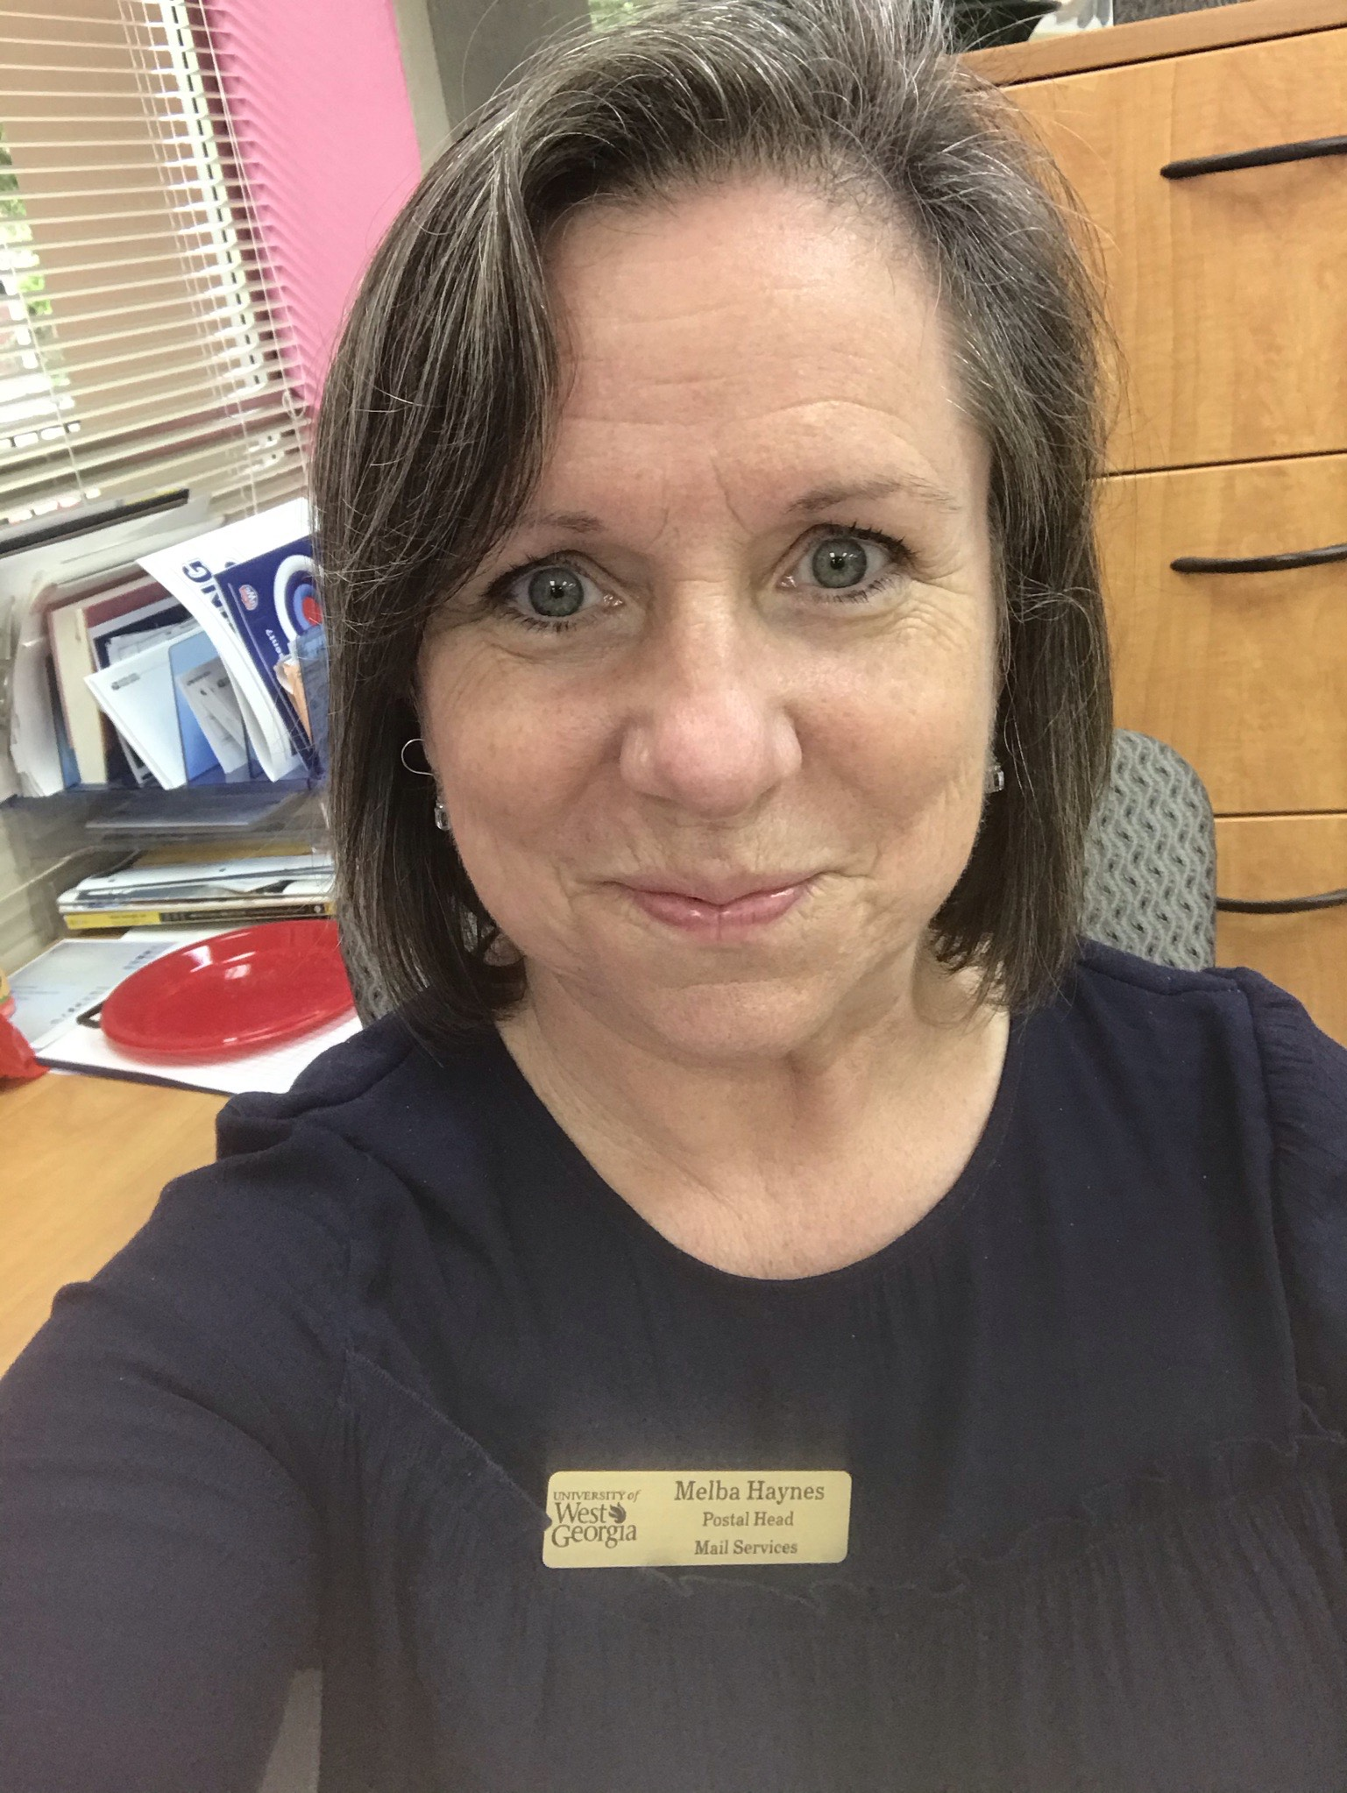
MELBA HAYNES
Postal Head in Mail Services
2000-2021
Plans for retirement: enjoying grandbabies, doing whatever she wants, organizing her new home, traveling

Slide 14
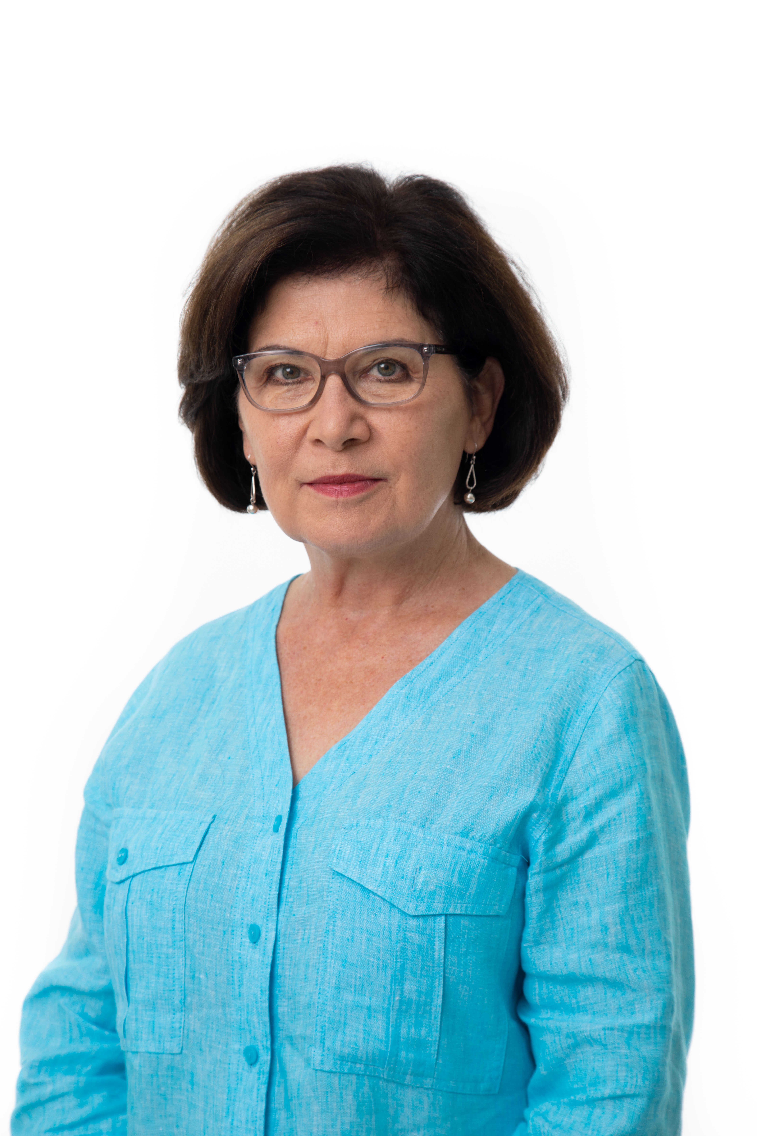
JILL HENDRICKS
Associate Director in Admissions and in Health Services
1981-1990; 2003-2020
Plans for retirement: being grateful for this time in her life, enjoying her wonderful family and friends to the fullest, soon having grandchildren to love and spoil, taking care of pets, and enjoying gardening, traveling, reading, and hiking

Slide 15
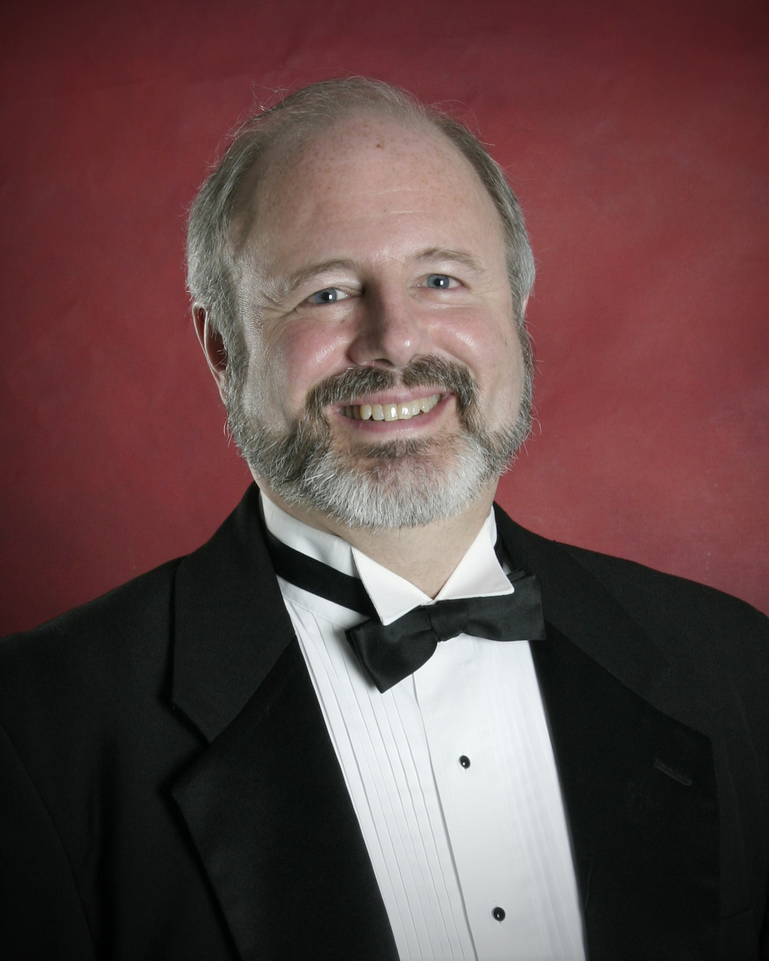
KEVIN HIBBARD
Director of Choirs; Professor and Chair of Music
1998-2020
Plans for retirement: resuming conducting his community chorus and church choir when it is safe to do so, exercising (walking, biking, perhaps taking up Pickleball), traveling, playing piano, reading

Slide 16
ALICE PEARL HOLLAND
Custodian in Campus Planning and Facilities/Custodial Services
1999-2020
Plans for retirement: traveling after the pandemic, gardening, cooking, attending the Senior Center, walking daily

Slide 17
LISA WOOD JACKSON
Assistant Director for Administrative Operations in Health Services
2009-2021
Plans for retirement: working at UWG as a retiree, spending time with children and grandchildren, traveling

Slide 18
DEBORAH LOVVORN
Custodian, Painter in Campus Planning and Facilities/ Custodial Services, Maintenance
2001-2020
Plans for retirement: going fishing with her husband, spending time with her grandchildren, going to estate and yard/garage sales, having a booth at Ruth’s Flea Market in Roanoke (on most Wednesdays)

Slide 19
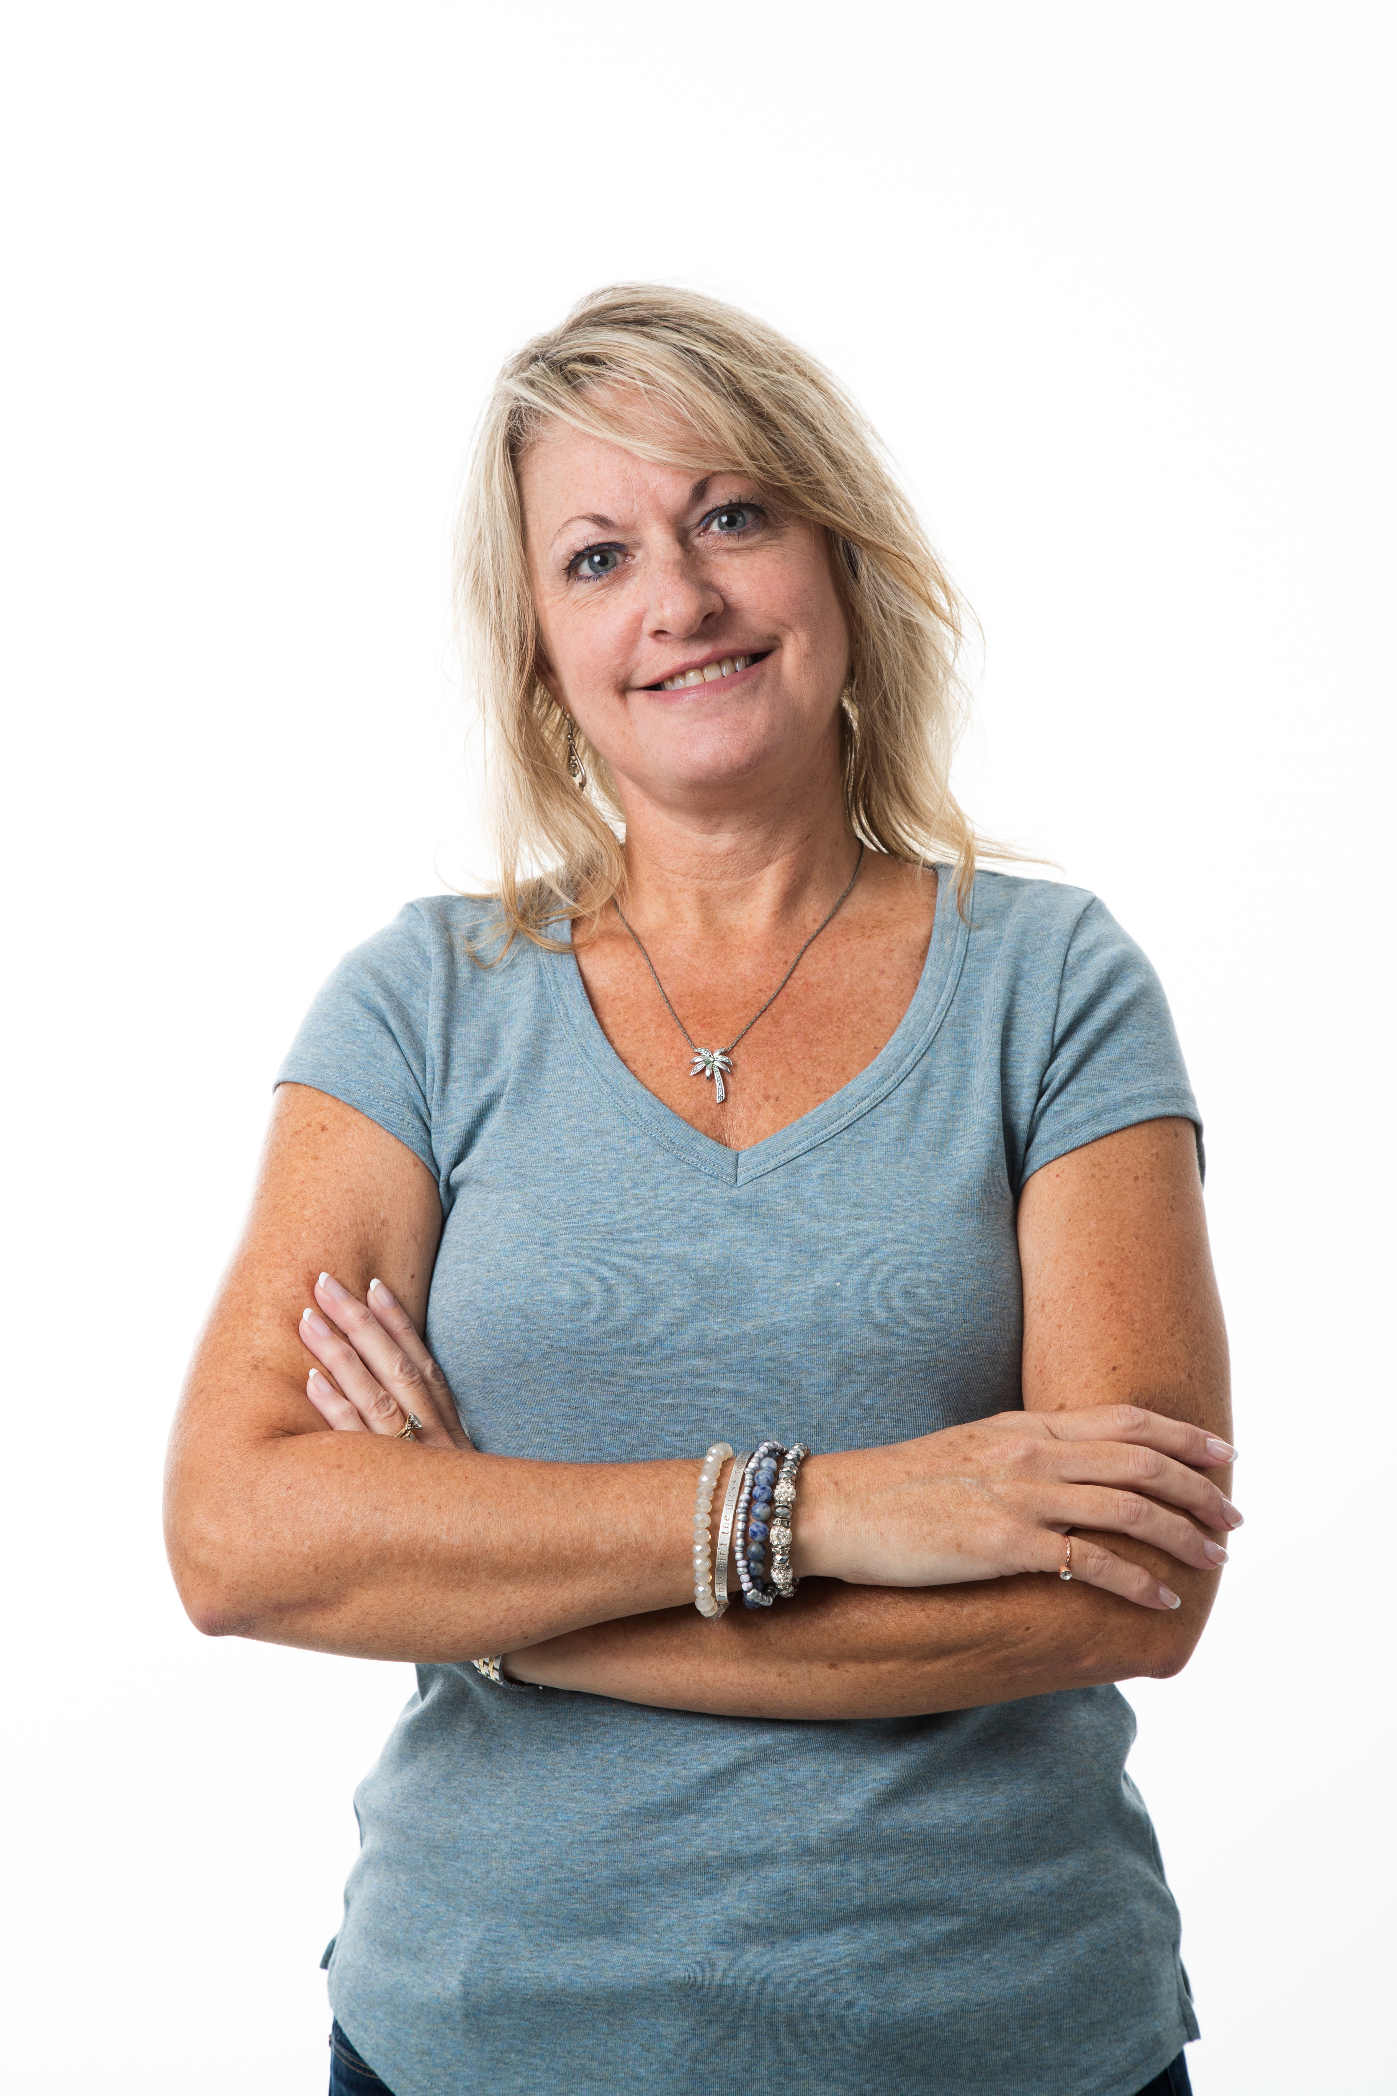
SHERYL BOSTWICK MARLAR
Records Coordinator in Public Safety
Communications Specialist in University Communications and Marketing
1998-2020
Plans for retirement: working part-time in Villa Rica; taking care of family, especially her mom; traveling, particularly to Colorado, Montana, and the Virgin Islands; tending to the family’s farmland

Slide 20
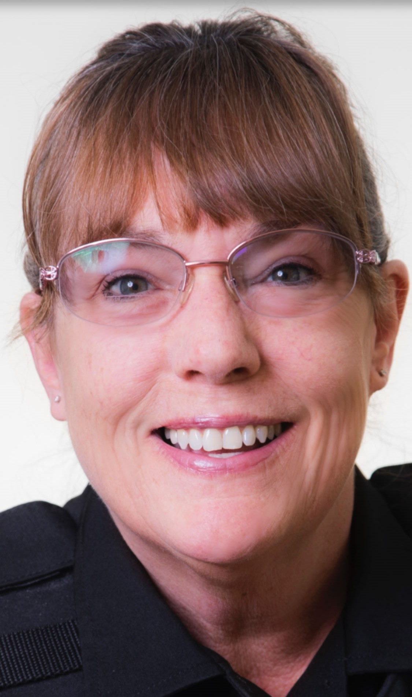
CAROLINE MARTIN
Master Patrol Officer in University Police Department
1991-2020
Plans for retirement: spending time with family, working part-time

Slide 21
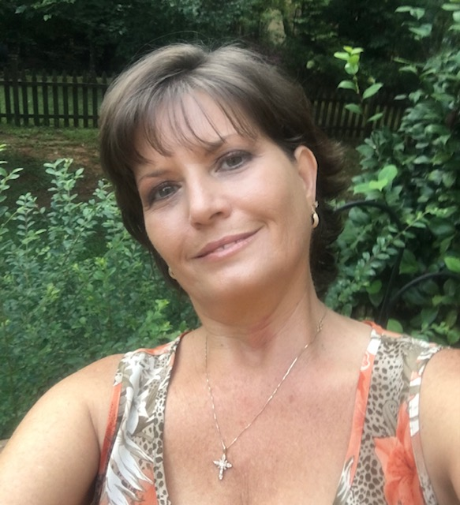
TERRI M. MURPHY
Administrative Assistant in Student Counseling Services
Senior Benefits Administrator in Human Resources
1993-2021
Plans for retirement: reading, taking care of her four dogs and four cats, and traveling with family, especially frequent trips to Florida

Slide 22
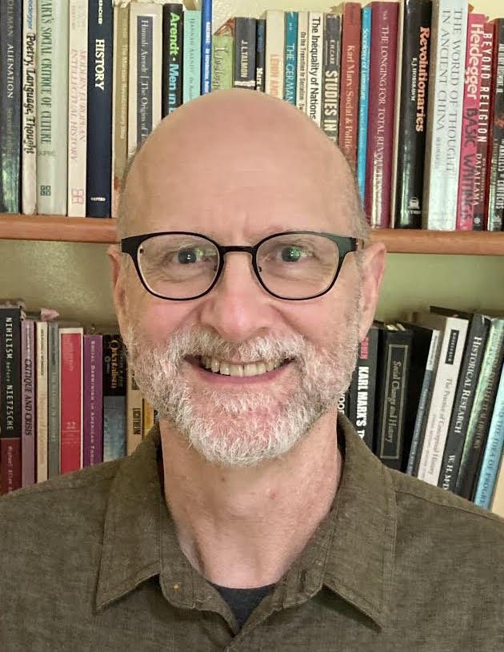
ALAN POPE
Professor of Psychology
2001-2020
Plans for retirement: Alongside paring down and simplifying, his retirement plan is to listen to situations and respond to them, abandon plans in favor of ideas, embrace ambiguity over certainty, develop creativity over habit, and use head in the service of heart. But that’s his plan. The likely reality is that he will continue, to borrow the words of the poet Gary Snyder, to think his own kind of dry, crusty thoughts.

Slide 23
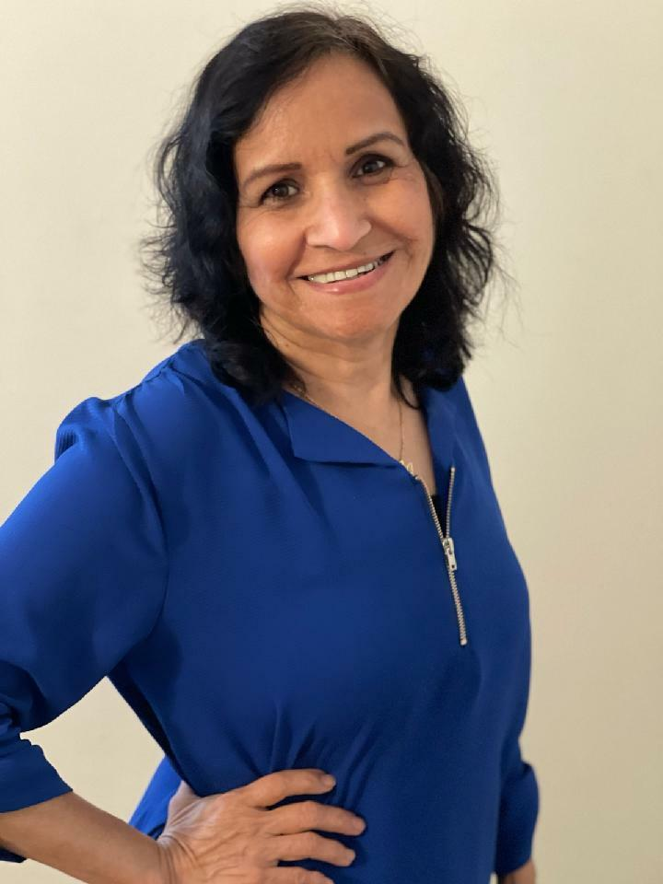
JOSEFINA RANGEL
Custodian Associate in Campus Planning and Facilities/Custodial Services
2008-2021
Plans for retirement: enjoying the time spent with family

Slide 24
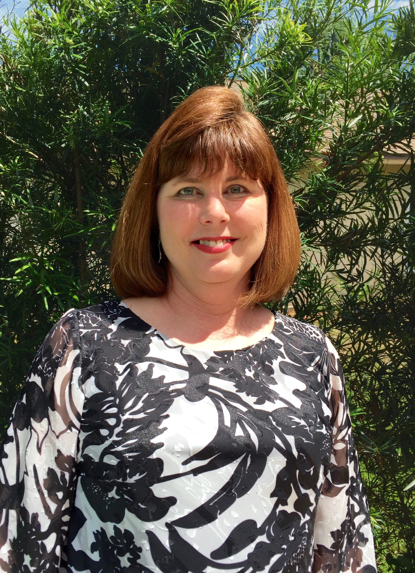
JANICE RIDGWAY
Department Assistant in Theatre, History, and Art, History, & Philosophy
2006-2020
Plans for retirement: moving to North Carolina, doing home projects, doing craft projects, spending more time with family

Slide 25
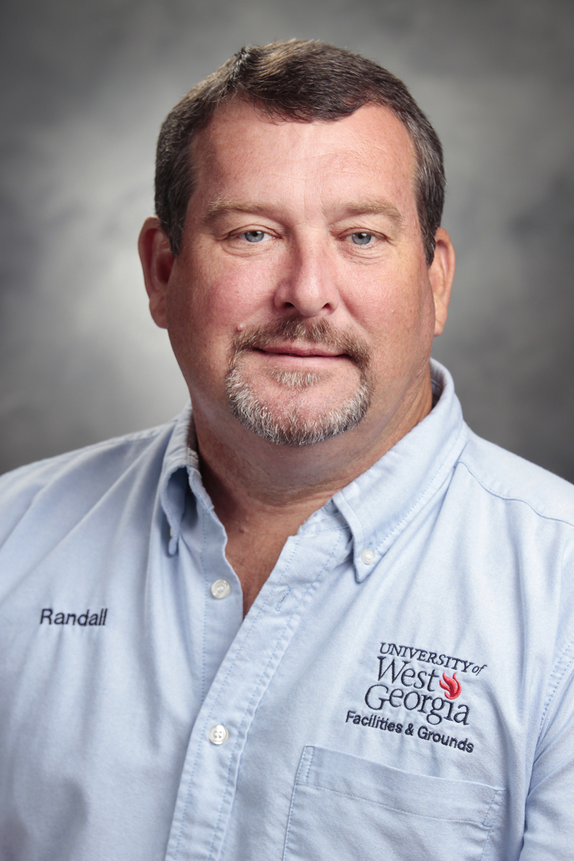
JAMES RANDALL ROLLINS
Maintenance and Carpentry Supervisor in Facilities and Grounds/Maintenance and Carpentry
2001-2021
Plans for retirement: doing some fishing and hunting, doing a little traveling, watching football and softball (especially college)

Slide 26
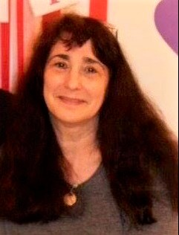
LIZ RUNYAN
Administrative Assistant in Management
1992-2020
Plans for retirement: enjoying crafts, such as quilting, stained glass, and woodwork; working on the family’s 18 acres of land; making trips to Missouri to visit her daughter and granddaughter

Slide 27
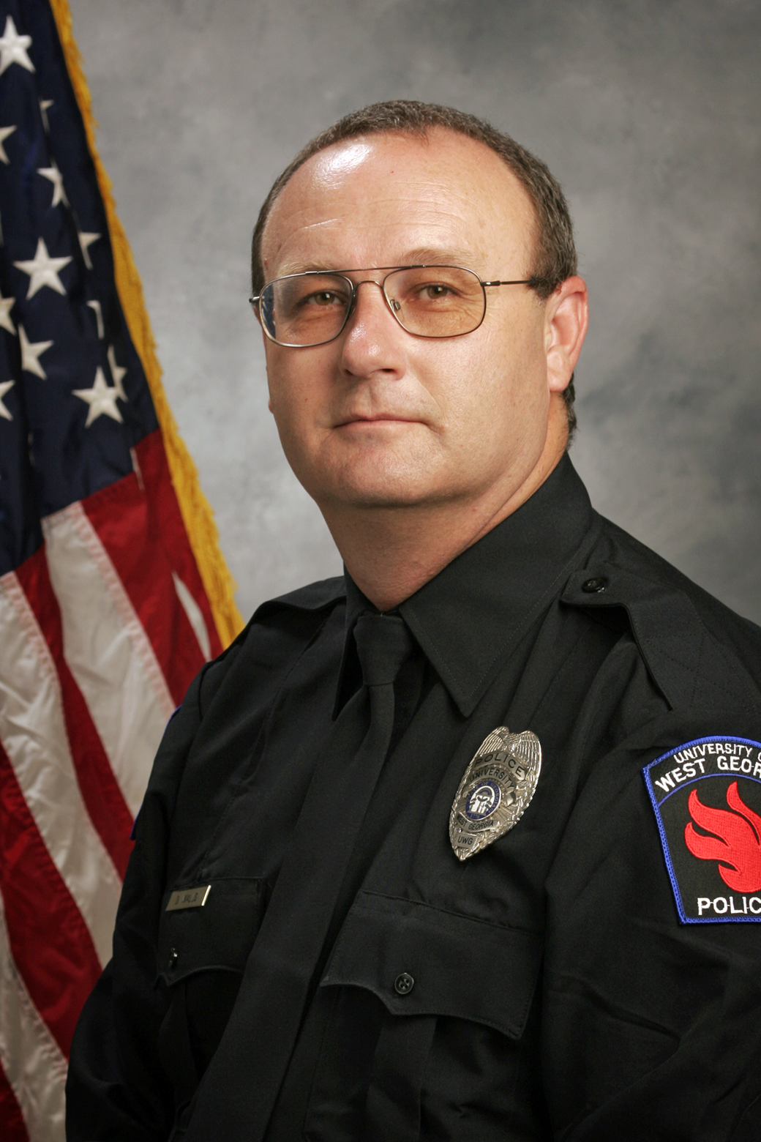
DALE WALLS
Master Sergeant in University Police Department
1986-1995; 2000-2021
Plans for retirement: gardening, working part-time with his brother in their construction business

Slide 28
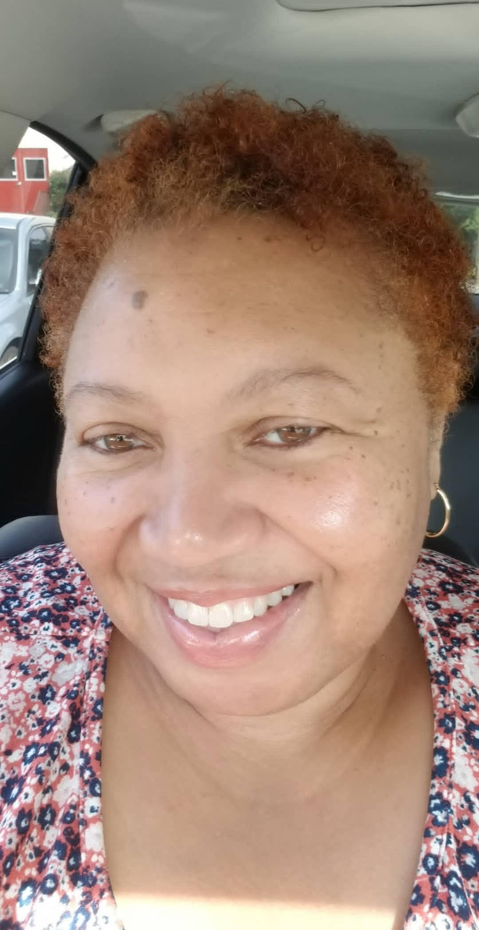
PATRICIA (TRISH) WELLS
Graduate Studies Associate in Dean’s Office, College of Social Sciences
1987-2020
Plans for retirement: visiting family and friends, volunteering with the IRS, and volunteering with church communities as the beginning to a great retirement

Slide 29
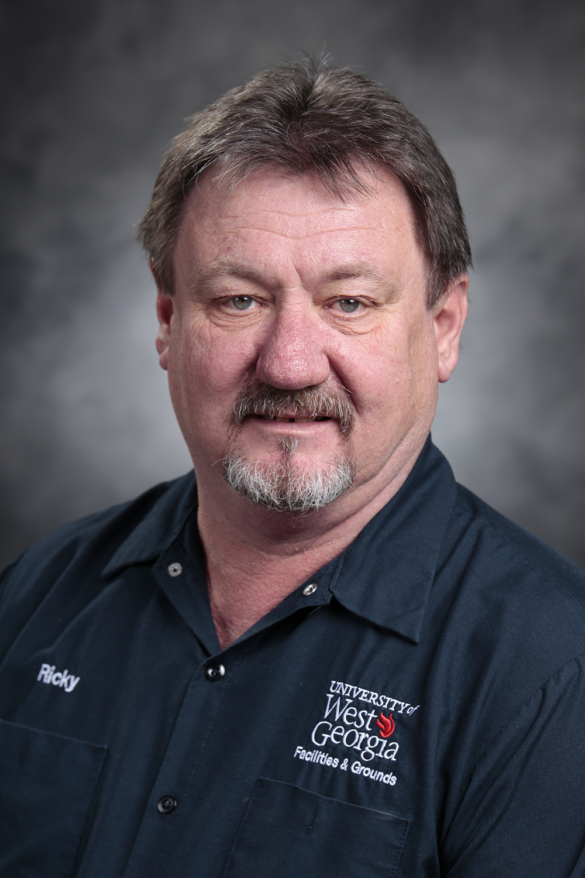
RICKY LEE WEST
Mechanic in Campus Planning and Facilities/Motor Pool
1992-2020
Plans for retirement: relaxing!

Slide 30
Recognition of Service
to the
Association of Retired Faculty & Staff

Slide 31
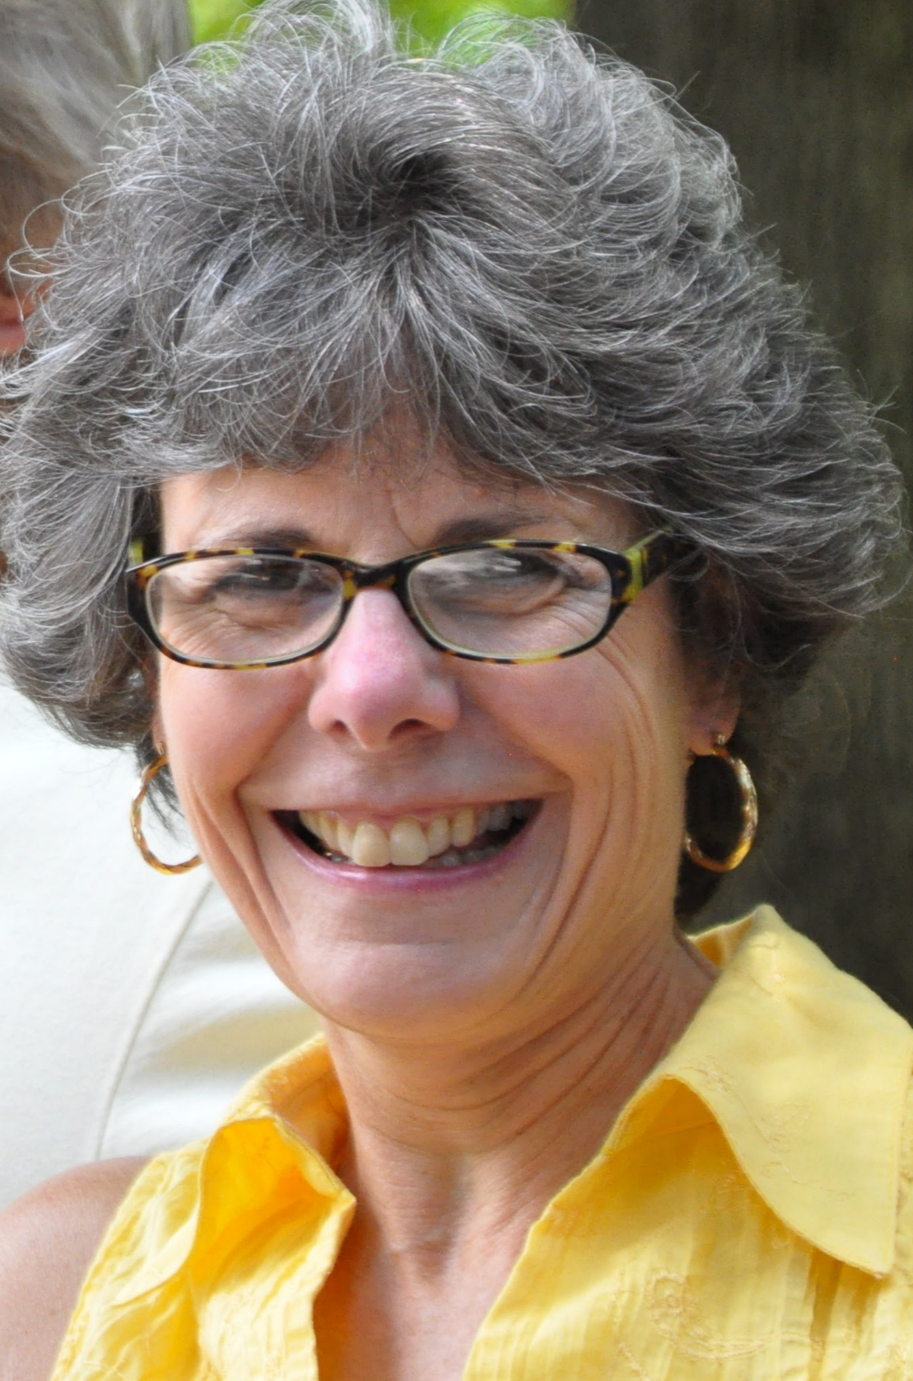
BONNIE BAR

Slide 32
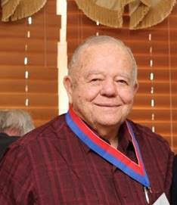
BOBBY POWELL

Slide 33
CONGRATULATIONS TO OUR RETIREES!

